Slide 1
Digital Circuit Experiment Asynchronous Integrated Counter
Lecture 6
Rencan Nie（聂仁灿）

Slide 2

Theoretical Basis
Counter
Modulus
The modulus of a counter is the number of unique states through which the counter will sequence. For a counter with $n$ flip-flops:
Maximum modulus: $2^{n}$ Possible outputs: $0 \sim 2^{n}−1$
Counters can be designed to have a number of states in their sequence that is less than the maximum of $2^{n}$ . This type of sequenceis called a truncated sequence.

Slide 3
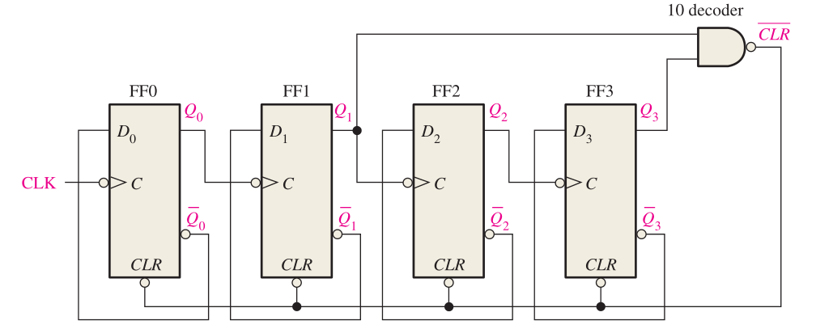
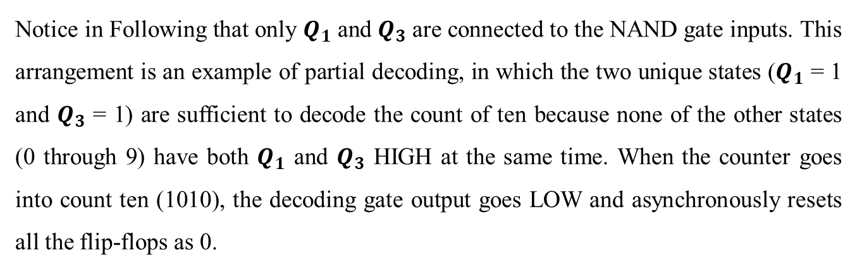
Theoretical Basis
Counter
Partial Decoding
Notice in Following that only $Q_{1}$ and $Q_{3}$ are connected to the NAND gate inputs. This arrangement is an example of partial decoding, in which the two unique states ($Q_{1}$ = 1 and $Q_{3}$ = 1) are sufficient to decode the count of ten because none of the other states (0 through 9) have both $Q_{1}$ and $Q_{3}$ HIGH at the same time. When the counter goes into count ten (1010), the decoding gate output goes LOW and asynchronously resets all the flip-flops as 0.
CP | Q₃Q₂Q₁Q₀
0 | 0 0 0 0
1 | 0 0 0 1
2 | 0 0 1 0
3 | 0 0 1 1
4 | 0 1 0 0
5 | 0 1 0 1
6 | 0 1 1 0
7 | 0 1 1 1
8 | 1 0 0 0
9 | 1 0 0 1
10 | 1 0 1 0
11 | 1 0 1 1
12 | 1 1 0 0
13 | 1 1 0 1
14 | 1 1 1 0
15 | 1 1 1 1

Slide 4
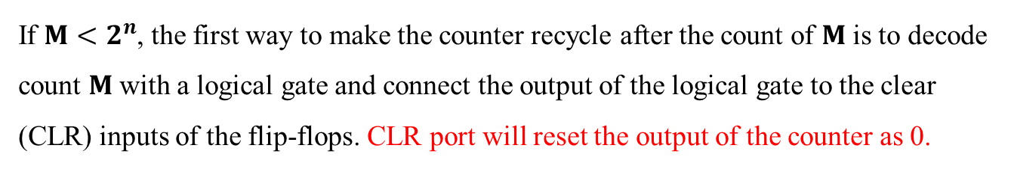
Theoretical Basis
Counter
Partial Decoding: CLR based method
If ${M<2}^{n}$, the first way to make the counter recycle after the count of $M$ is to decode count $M$ with a logical gate and connect the output of the logical gate to the clear (CLR) inputs of the flip-flops. CLR port will reset the output of the counter as 0.
CP | Q₃Q₂Q₁Q₀
0 | 0 0 0 0
1 | 0 0 0 1
2 | 0 0 1 0
3 | 0 0 1 1
4 | 0 1 0 0
5 | 0 1 0 1
6 | 0 1 1 0
7 | 0 1 1 1
8 | 1 0 0 0
9 | 1 0 0 1
10 | 1 0 1 0
11 | 1 0 1 1
12 | 1 1 0 0
13 | 1 1 0 1
14 | 1 1 1 0
15 | 1 1 1 1
0：0000
1：0001
2：0010
3：0011
4：0100
5：0101
15：1111
6：0000
Recycle with M = 10 states
14：1110
7：0110
13：1101
12：1100
11：1011
10：1001
9：1001
8：1000
transient state

Slide 5
Theoretical Basis
Counter
Partial Decoding: CLR based method
Example 1:
pls design 11 modulus asynchronous counter using JK-FF, employing CLR based method
Step 1: give the state transition diagram
CP | Q₃Q₂Q₁Q₀
0 | 0 0 0 0
1 | 0 0 0 1
2 | 0 0 1 0
3 | 0 0 1 1
4 | 0 1 0 0
5 | 0 1 0 1
6 | 0 1 1 0
7 | 0 1 1 1
8 | 1 0 0 0
9 | 1 0 0 1
10 | 1 0 1 0
11 | 1 0 1 1
12 | 1 1 0 0
13 | 1 1 0 1
14 | 1 1 1 0
15 | 1 1 1 1
0：0000
1：0001
2：0010
3：0011
4：0100
5：0101
6：0000
Recycle with M = 11 states
7：0110
11：1011
10：1001
9：1001
8：1000
transient state

Slide 6
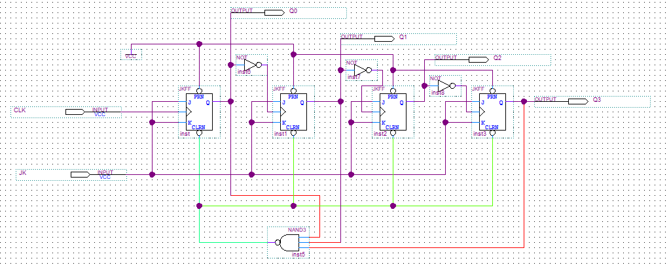
Theoretical Basis
Counter
Partial Decoding: CLR based method
Example: pls design 11 asynchronous modulus counter using JK-FF, employing CLR based method
Step 2: design the circuit expected
The logical gate is designed based on the transient state
The logical gate is connected with CLR
CP | Q₃Q₂Q₁Q₀
0 | 0 0 0 0
1 | 0 0 0 1
2 | 0 0 1 0
3 | 0 0 1 1
4 | 0 1 0 0
5 | 0 1 0 1
6 | 0 1 1 0
7 | 0 1 1 1
8 | 1 0 0 0
9 | 1 0 0 1
10 | 1 0 1 0
11 | 1 0 1 1
12 | 1 1 0 0
13 | 1 1 0 1
14 | 1 1 1 0
15 | 1 1 1 1

Slide 7
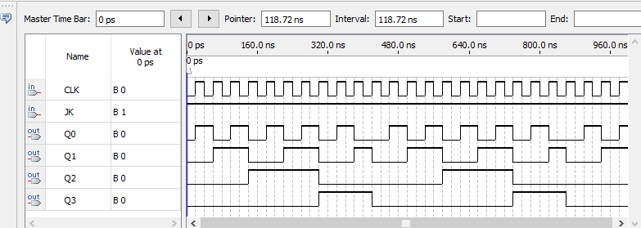
Theoretical Basis
Counter
Partial Decoding: CLR based method
Example 1: pls design 11 modulus asynchronous counter using JK-FF, employing CLR based method
Step 3: Simulation results
CP | Q₃Q₂Q₁Q₀
0 | 0 0 0 0
1 | 0 0 0 1
2 | 0 0 1 0
3 | 0 0 1 1
4 | 0 1 0 0
5 | 0 1 0 1
6 | 0 1 1 0
7 | 0 1 1 1
8 | 1 0 0 0
9 | 1 0 0 1
10 | 1 0 1 0
11 | 1 0 1 1
12 | 1 1 0 0
13 | 1 1 0 1
14 | 1 1 1 0
15 | 1 1 1 1
11

Slide 8
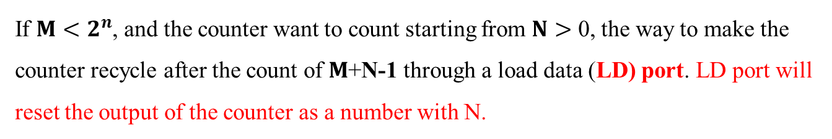

Theoretical Basis
Counter
Partial Decoding: LD based method
If ${M<2}^{n}$, and the counter want to count starting from $N>$ 0, the way to make the counter recycle after the count of $M$+N-1 through a load data (LD) port. LD port will reset the output of the counter as a number with N.
CP | Q₃Q₂Q₁Q₀
0 | 0 0 0 0
1 | 0 0 0 1
2 | 0 0 1 0
3 | 0 0 1 1
4 | 0 1 0 0
5 | 0 1 0 1
6 | 0 1 1 0
7 | 0 1 1 1
8 | 1 0 0 0
9 | 1 0 0 1
10 | 1 0 1 0
11 | 1 0 1 1
12 | 1 1 0 0
13 | 1 1 0 1
14 | 1 1 1 0
15 | 1 1 1 1
$$N=3$$
0：0000
1：0001
2：0010
3：0011
4：0100
5：0101
15：1111
Recycle with M =10 states
6：0000
14：1110
Counting N=3 through 12
7：0110
13：1101
12：1100
11：1011
10：1001
9：1001
8：1000

Slide 9
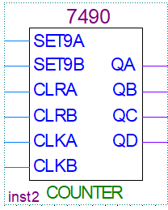
Theoretical Basis
Integrated Asynchronous Counter
74LS90
74LS290 is a integrated asynchronous counter.
Contain two counters
A: output QA (2 modulus)
B: output QD QC QB (5 modulus)
CLK ports:
CLKA: the clock of A counter
CLKB: the clock of B counter
CLR ports:
If CLRA = CLRA=1, QD QC QB QA = 0 0 0 0
Setting 9 ports:
If SET9A = SET9B=1, QD QC QB QA = 1 0 0 1

Slide 10
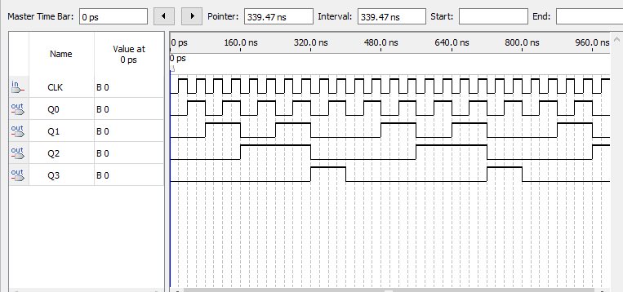
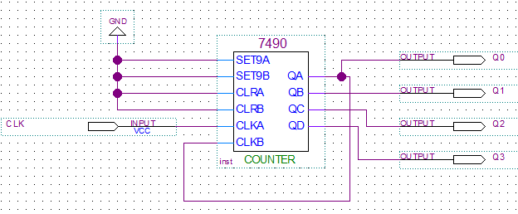
Theoretical Basis
Integrated Asynchronous Counter
How to Design a asynchronous counter using 74LS90
Example 2: Pls design a counter with 10 modulus
Tips:
A 74LS290 just has maximal modulus with 2X5=10
A Cascaded counter using two counters A and B
Disable CLR and SET9 ports

Slide 11
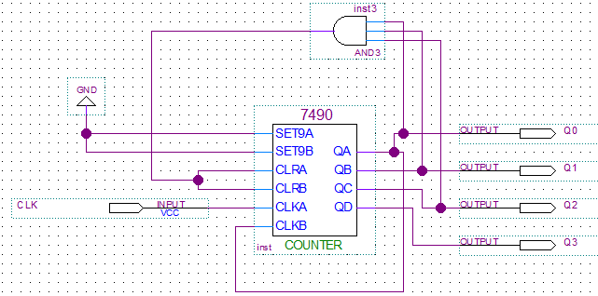
Theoretical Basis
Integrated Asynchronous Counter
How to Design a asynchronous counter using 74LS90
Example 3: Pls design a counter with 7 modulus
Tips:
Design a 10 modulus counter firstly
Enable CLR, when Q₃Q₂Q₁Q₀=7 (0111)
Disable SET9 ports

Slide 12
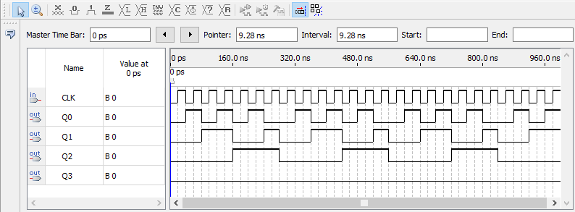
Theoretical Basis
Integrated Asynchronous Counter
How to Design a asynchronous counter using 74LS90
Example 3: Pls design a counter with 7 modulus -----(simulation results)

Slide 13
Theoretical Basis
Integrated Asynchronous Counter
How to Design a asynchronous counter using 74LS90
Example 4: Pls design a counter with 56 modulus
Tips (method1):
Design a 10x10 modulus counter firstly
Enable CLR, when Q₇Q₆Q₅Q₄Q₃Q₂Q₁Q₀=56 (00111000), that is Q₅Q₄Q₃=111
Disable SET9 ports

Slide 14
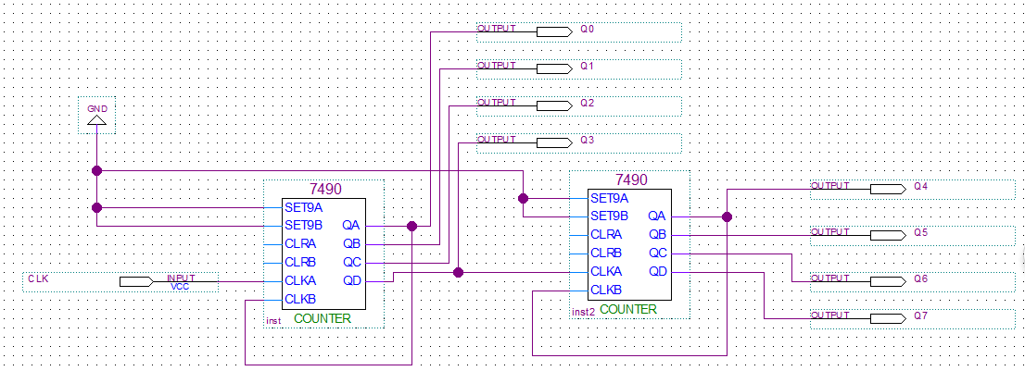
Theoretical Basis
Integrated Asynchronous Counter
How to Design a asynchronous counter using 74LS90
Example 4: Pls design a counter with 56 modulus
Step1: Design a counter with 100 modulus
method1

Slide 15
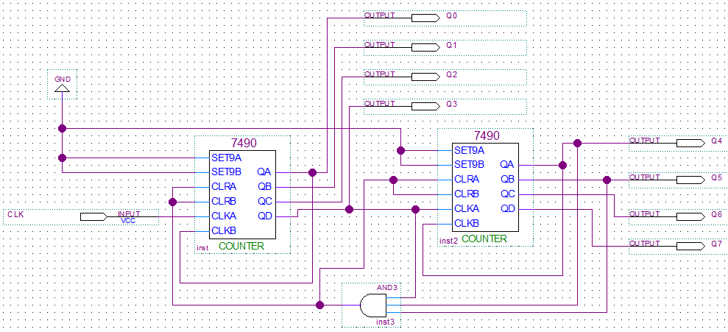
Theoretical Basis
Integrated Asynchronous Counter
How to Design a asynchronous counter using 74LS90
Example 4: Pls design a counter with 56 modulus
Step2: Enable CLR, when Q₇Q₆Q₅Q₄Q₃Q₂Q₁Q₀=56 (00111000), that is Q₅Q₄Q₃=111
method1

Slide 16
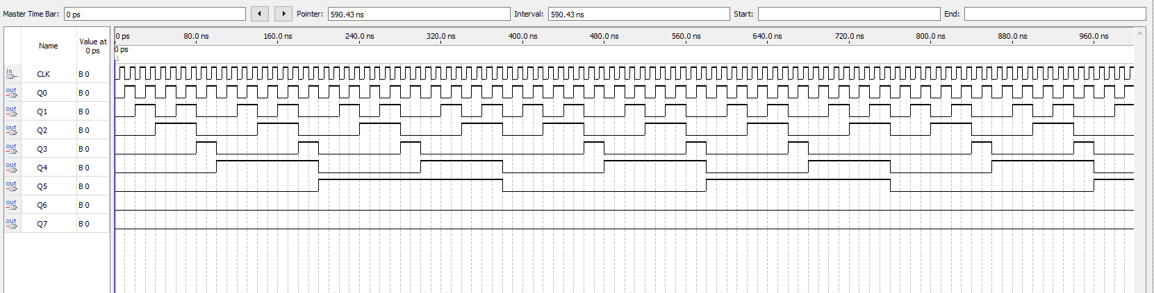
Theoretical Basis
Integrated Asynchronous Counter
How to Design a asynchronous counter using 74LS90
Example 4: Pls design a counter with 56 modulus
Step3: watch the simulation results
method1

Slide 17
Theoretical Basis
Integrated Asynchronous Counter
How to Design a asynchronous counter using 74LS90
Example 5: Pls design a counter with 56 modulus
Tips (method2):
Design 7, 8 modulus counter respectively, because 7x8=56
Cascade those of two counters.
Disable SET9 ports in those of two counters

Slide 18
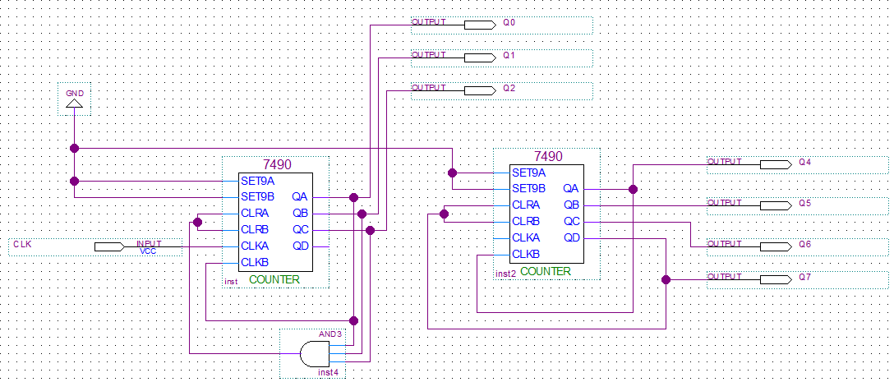
Theoretical Basis
Integrated Asynchronous Counter
How to Design a asynchronous counter using 74LS90
Example 5: Pls design a counter with 56 modulus
Step1: Design 7, 8 modulus counter respectively
method2
7 modulus
8 modulus

Slide 19
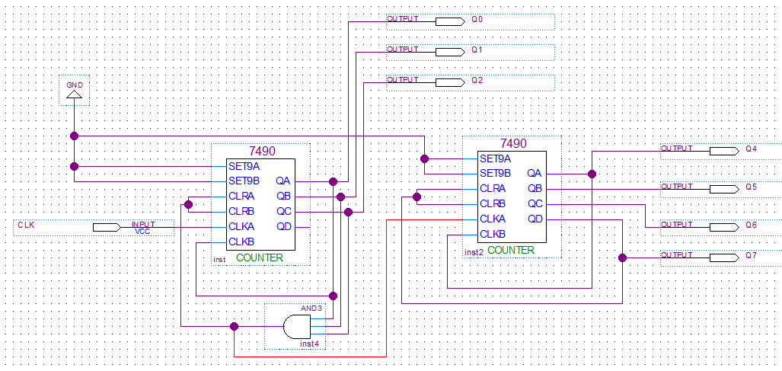
Theoretical Basis
Integrated Asynchronous Counter
How to Design a asynchronous counter using 74LS90
Example 5: Pls design a counter with 56 modulus
Step2: Cascade those of two counters.
Method 2

Slide 20
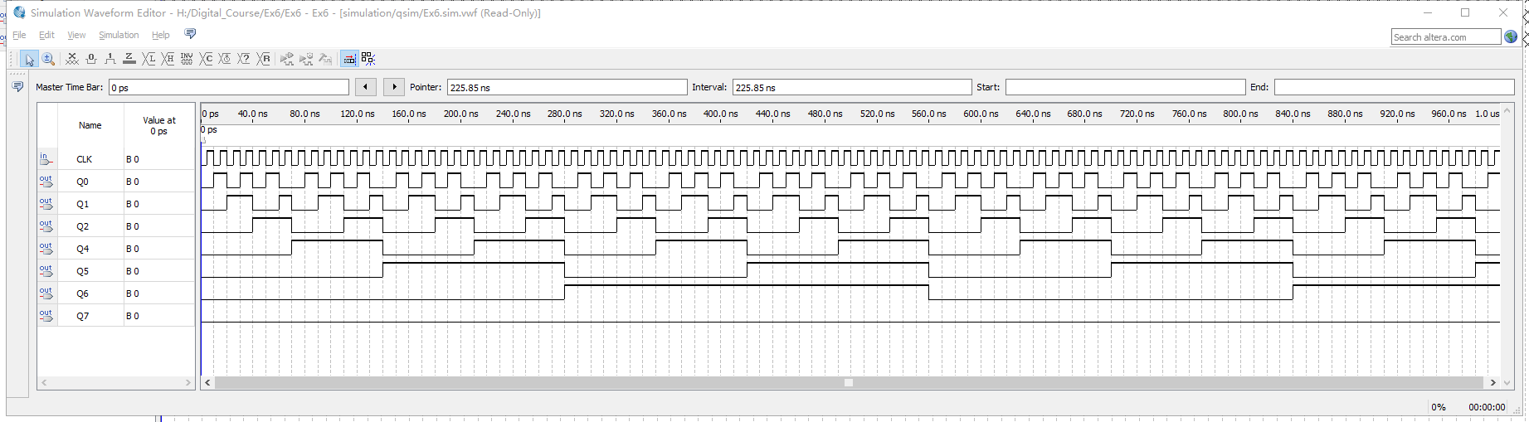
Theoretical Basis
Integrated Asynchronous Counter
How to Design a asynchronous counter using 74LS90
Example 5: Pls design a counter with 56 modulus
Step3: watch the simulation results
method2

Slide 21
Experiments
Experimental purposes
Understand how to design and test a M-modules asynchronous counter using JK-FF, resorting to CLR port.
Based on the total CLR based method, understand how to design and test a M-modules asynchronous counter, through integrated chips.
Based on the multi-modulus cascade-based method, understand how to design and test a M-modules asynchronous counter, through integrated chins.

Slide 22
Experimental Contents
Task 1. Design and test a 13 modules asynchronous counter with JK-FF
Step 1: Design a 13 modules asynchronous counter using JK-FF
Pls consult the Example 1!!!
Step 2: input the counting pulses to the designed counter, then test and record the waves for different output bits with Q₃~Q_{0.}

Slide 23
Experimental Contents
Task 2. Design and test a 6 modules asynchronous counter with 74LS90
Step 1: Design a 6 modules asynchronous counter using 74LS90
Pls consult the Example 3!!!
Step 2: input the counting pulses to the designed counter, then test and record the waves for different output bits with Q₃~Q_{0.}

Slide 24
Experimental Contents
Task 3. Design and test a 69 modules asynchronous counter with 74LS90
Step 1: Design a 69 modules asynchronous counter using 74LS90, based on the total CLR based method.
Pls consult the Example 4!!!
Step 2: input the counting pulses to the designed counter, then test and record the waves for different output bits with Q₇~Q_{0.}

Slide 25
Experimental Contents
Task 3. Design and test a 69 modules asynchronous counter with 74LS90
Step 1: Design a 69 modules asynchronous counter using 74LS90, Based on the multi-modulus cascade-based method, that is 54=6*9.
Pls consult the Example 5!!!
Step 2: input the counting pulses to the designed counter, then test and record the waves for different output bits with Q₇~Q_{0.}

Slide 26
Thanks

